Slide 1

PREDICTING RESTAURANT SUCCESS BASED ON YELP DATASET
Team Watson
Shivani Mangal (012530362)
Hemang Behl (013734214)
Prajwal Venkatesh (012557792)

Slide 2
Introduction
The restaurant industry is the second largest employing industry in United States and it’s demand is an ever-increasing one (Mandabach, 2011).
Yelp, one of the most used websites today, is a pool of data. It is a local search service and a crowd sourced forum for various businesses, from restaurants to boutiques. People from around the world, rate these businesses and share their reviews for the same.
The main objective of our extensive analysis on the yelp dataset is to aid in the success of local restaurants.
We have chosen the following criteria for a restaurant to be a successful it needs to pass certain benchmark. To name a few. They,
should be in a location which is popular among people
should end up having a star rating of 3.5 or above
should have low general noise level for it to be appealing to people
should have good reviews from guests
should have a high footfall in general as compared to other restaurants
In order to understand and predict the success of a restaurant, we have split our analysis into multiple sections or use cases.

Slide 3
Data Pre-processing
JSON to CSV conversion:
Used the pandas dataframe so we converted all the json files into csv
Generated new dataset by joining:
Generated new csv files with required columns
Reducing the dataset
The size of the review data set was very large so we reduced the dataset to 30 % of the original data. We did this because the data size is beyond what our machines could handle

Slide 4
Classifying restaurant review as positive or negative
Convert document corpus to a vector format we have used bag-of-words approach.
Used NLTK library available on python to remove stopwords and punctuations converting reviews into list of tokens.
Used Scikit-learn’s CountVectorizer to convert the text documents into a matrix of token counts.
Used TfidfVectorizer on the reviews and transformed into document-term matrix
Have split the dataset using train_test_split from Scikit-learn.
Have used 70% of the dataset for training the model and 30%for testing.

Slide 5
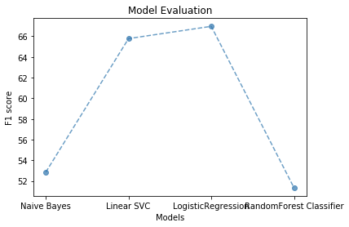
Different models used
Fig : Plot of F1 scores for different model for classifying reviews
Model | F1 Score
Naive Bayes | 52.85
Random Forest classifier | 51.34
Linear SVC | 65.78
Logistic Regression | 66.96

Slide 6
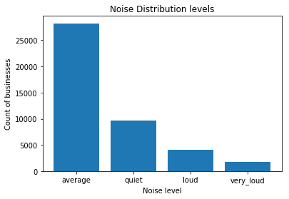
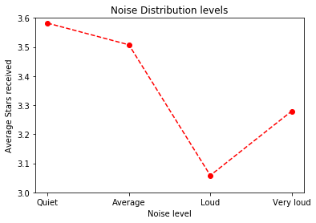
Noise, Footfall Pattern and Business Closure analysis
Aim 1: Find how noise levels effect star ratings
People tend to give less ratings to places with high levels of noise
Notes:
groupby(['business_id'])['stars'].agg('count') -->pivot_table → merge business and review

Slide 7
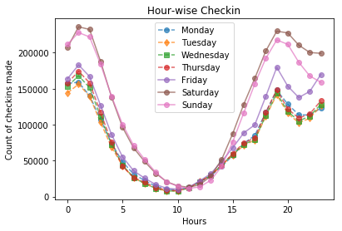
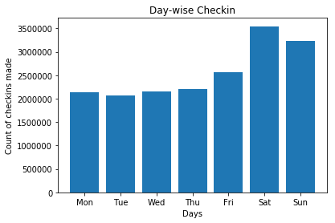
Aim 2: Footfall Pattern Analysis
We found that businesses have a peak time around 7-8 PM and then again around 1-3 AM. The overall footfall was found to be higher on weekends as expected.

Slide 8
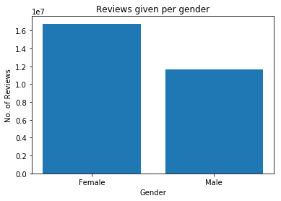
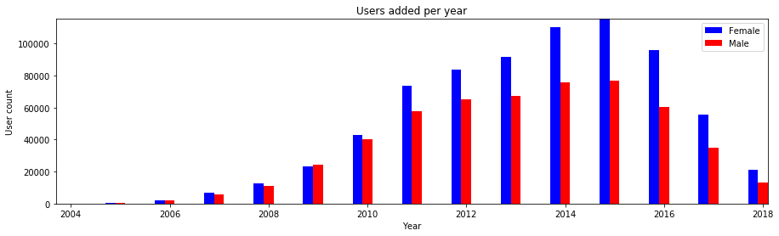
Feature creation: Using SSA datatset
Extracted the unique names from the 138 files [1880 to 2016] and exported it
Created a dictionary { name:gender }
Mapped it to the first name given in the user dataset
Percentage of genders: Female: 48%, Male:35%, Unknown:16%
Notes:
women gave 15% more reviews than men & 30% more women had joined yelp since 2012 every year with 2007 having equal account creation

Slide 9
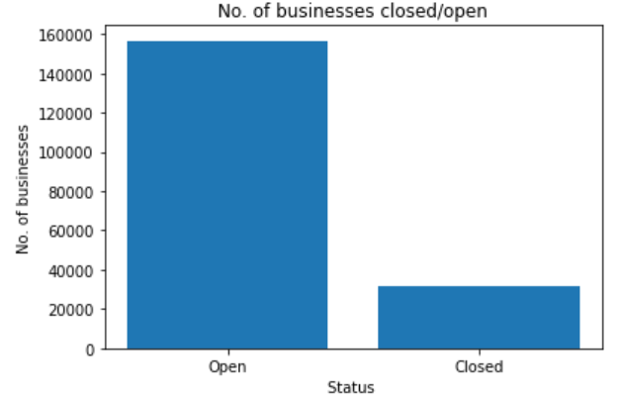
Aim 3: Will a business close or not
Merged datasets:
review, business and checkin
Imbalanced data
Notes:
Data is skewed, 80% is open, attributes such as review_count, medianStars, mean stars, checkin count were more significant

Slide 10
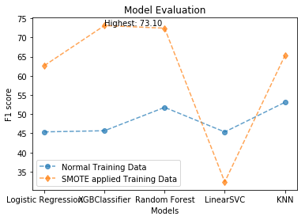
We are able to predict whether a business will close or not with a F1-score of 73.1%
MODEL | F1 score | F1- SMOTE
Logistic Regression | 45.38 | 62.66
XGBoost classifier max_depth=7, min_child_weight=1 | 45.68 | 73.10
Random Forest classifier min_samples_split=2, n_estimators=10, min_samples_leaf=1 | 51.77 | 72.39
Linear SVC loss ='hinge', penalty=’l2’, tol=0.0001 | 45.36 | 32.39
KNeighbors Classifier n_neighbors=1, metric=’minkowski’ | 53.08 | 65.25

Slide 11
Geo-Location and Cuisine Analysis
“Where should I open my next sandwich shop?”
“Should I open a chipotle, next to Agave?”
Manual site selection - a baffling problem
Quantify hard to quatify data like willingness to travel
Use these to predict demand
Using Geo-location from yelp

Slide 12
Analysis Done on Geo Location & Cuisine Data
Cuisine to Stars Correlation
Location to Stars Correlation
Finding best postal codes for restaurants
Clustering Lat/Lon to identify closeby business
Classification of restaurant based on location based features
Classification of restaurant based on location feautures and cuisine features

Slide 13
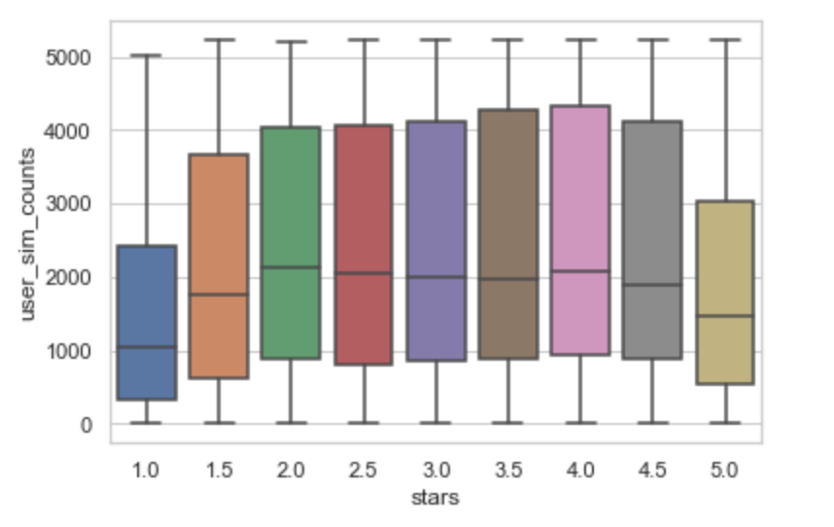
Count of nearby restaurant with similar users visiting

Slide 14
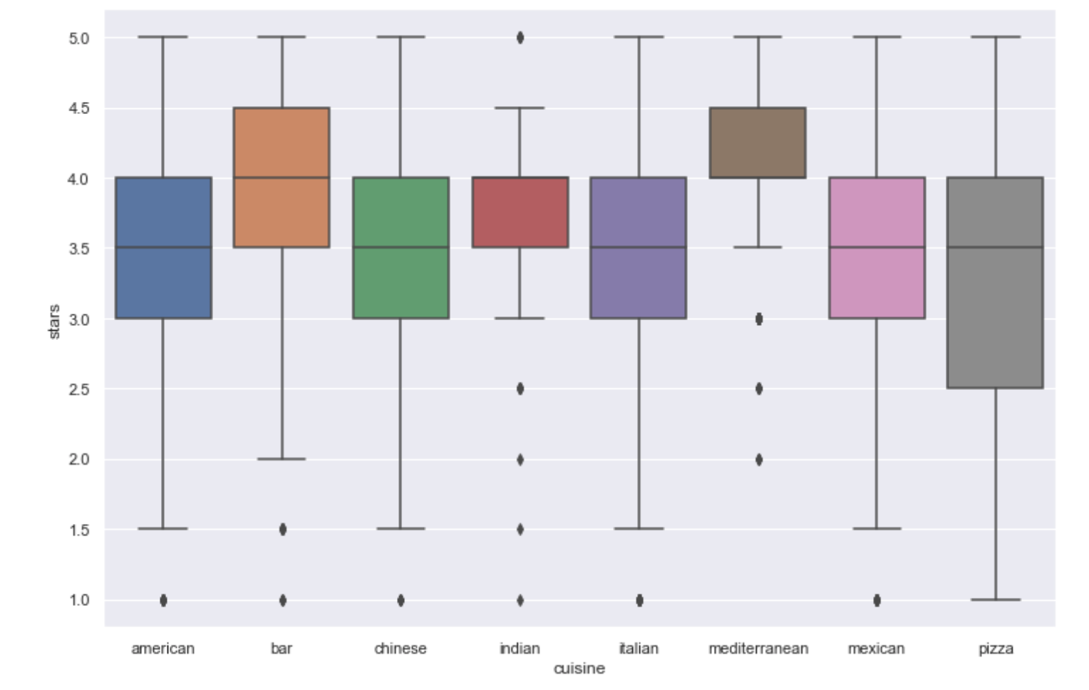
Cuisine to Stars Correlation

Slide 15
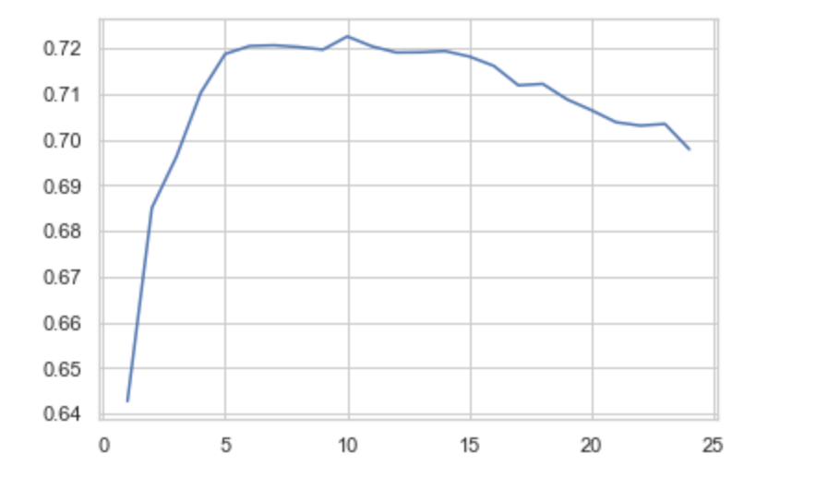
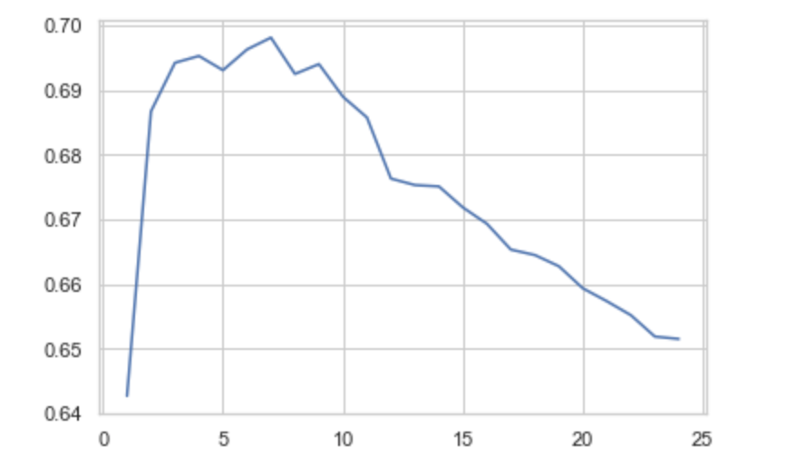
Supervised Learning: Analysis of Decision Trees

Slide 16
Models Used
Location and Cuisine Features affecting Star Rating(Analysis metric: accuracy) | Decision Tree | 0.65
 | Lasso Regression | 0.695
 | Gradient Boosted Tree | 0.75034
 | SVC | 0.745
 | Random Forest Classifier | 0.712
Cuisine Features affecting star rating( Analysis Metric Used: Accuracy) | Decision Tree | 0.746
 | Lasso Regression | 0.7233
 | SVC | 0.661
 | Gradient Boosted Tree | 0.7461

Slide 17
Results
Business Closure prediction: XGBoost gave a F1 score of 73.10%
Noise level does have an effect on the ratings
Businesses have a peak time around 7-8 PM and then again around 1-3 AM
Gradient boosted trees perform the best when it comes to using location data to analyze star rating with a score of 75%
Logistic regression worked best for classifying reviews with a F1 score of 66.96%

Slide 18
Conclusion
If a person is willing to start a restaurant business and decides to look at the yelp dataset, our review classification would help them by giving insight to make good business decisions according to the customer likes and dislikes.
Based on our analysis, the assumptions made by us in selecting the success criteria has been proved right.

